Slide 1
Fast Start Lab
ECI09T495BH - CloudForms and Ansible Value Prop Lab - Part 2

Slide 2
Legal Disclaimer
© IBM Corporation 2020. All Rights Reserved.
The information contained in this publication is provided for informational purposes only. While efforts were made to verify the completeness and accuracy of the information contained in this publication, it is provided AS IS without warranty of any kind, express or implied. In addition, this information is based on IBM’s current product plans and strategy, which are subject to change by IBM without notice. IBM shall not be responsible for any damages arising out of the use of, or otherwise related to, this publication or any other materials. Nothing contained in this publication is intended to, nor shall have the effect of, creating any warranties or representations from IBM or its suppliers or licensors, or altering the terms and conditions of the applicable license agreement governing the use of IBM software.
References in this presentation to IBM products, programs, or services do not imply that they will be available in all countries in which IBM operates. Product release dates and/or capabilities referenced in this presentation may change at any time at IBM’s sole discretion based on market opportunities or other factors, and are not intended to be a commitment to future product or feature availability in any way. Nothing contained in these materials is intended to, nor shall have the effect of, stating or implying that any activities undertaken by you will result in any specific sales, revenue growth or other results.
Performance is based on measurements and projections using standard IBM benchmarks in a controlled environment. The actual throughput or performance that any user will experience will vary depending upon many factors, including considerations such as the amount of multiprogramming in the user's job stream, the I/O configuration, the storage configuration, and the workload processed. Therefore, no assurance can be given that an individual user will achieve results similar to those stated here.
All customer examples described are presented as illustrations of how those customers have used IBM products and the results they may have achieved. Actual environmental costs and performance characteristics may vary by customer.

Slide 3
CP4MCM - CEM & Ansible Tower Integration
Target VM will be monitored using ICAM OS agent.
ICAM will send alarms to CEM on failure of Nginx container.
CEM can trigger a Runbook to trigger a job template in ansible tower to run an automation for resolution.

Slide 4
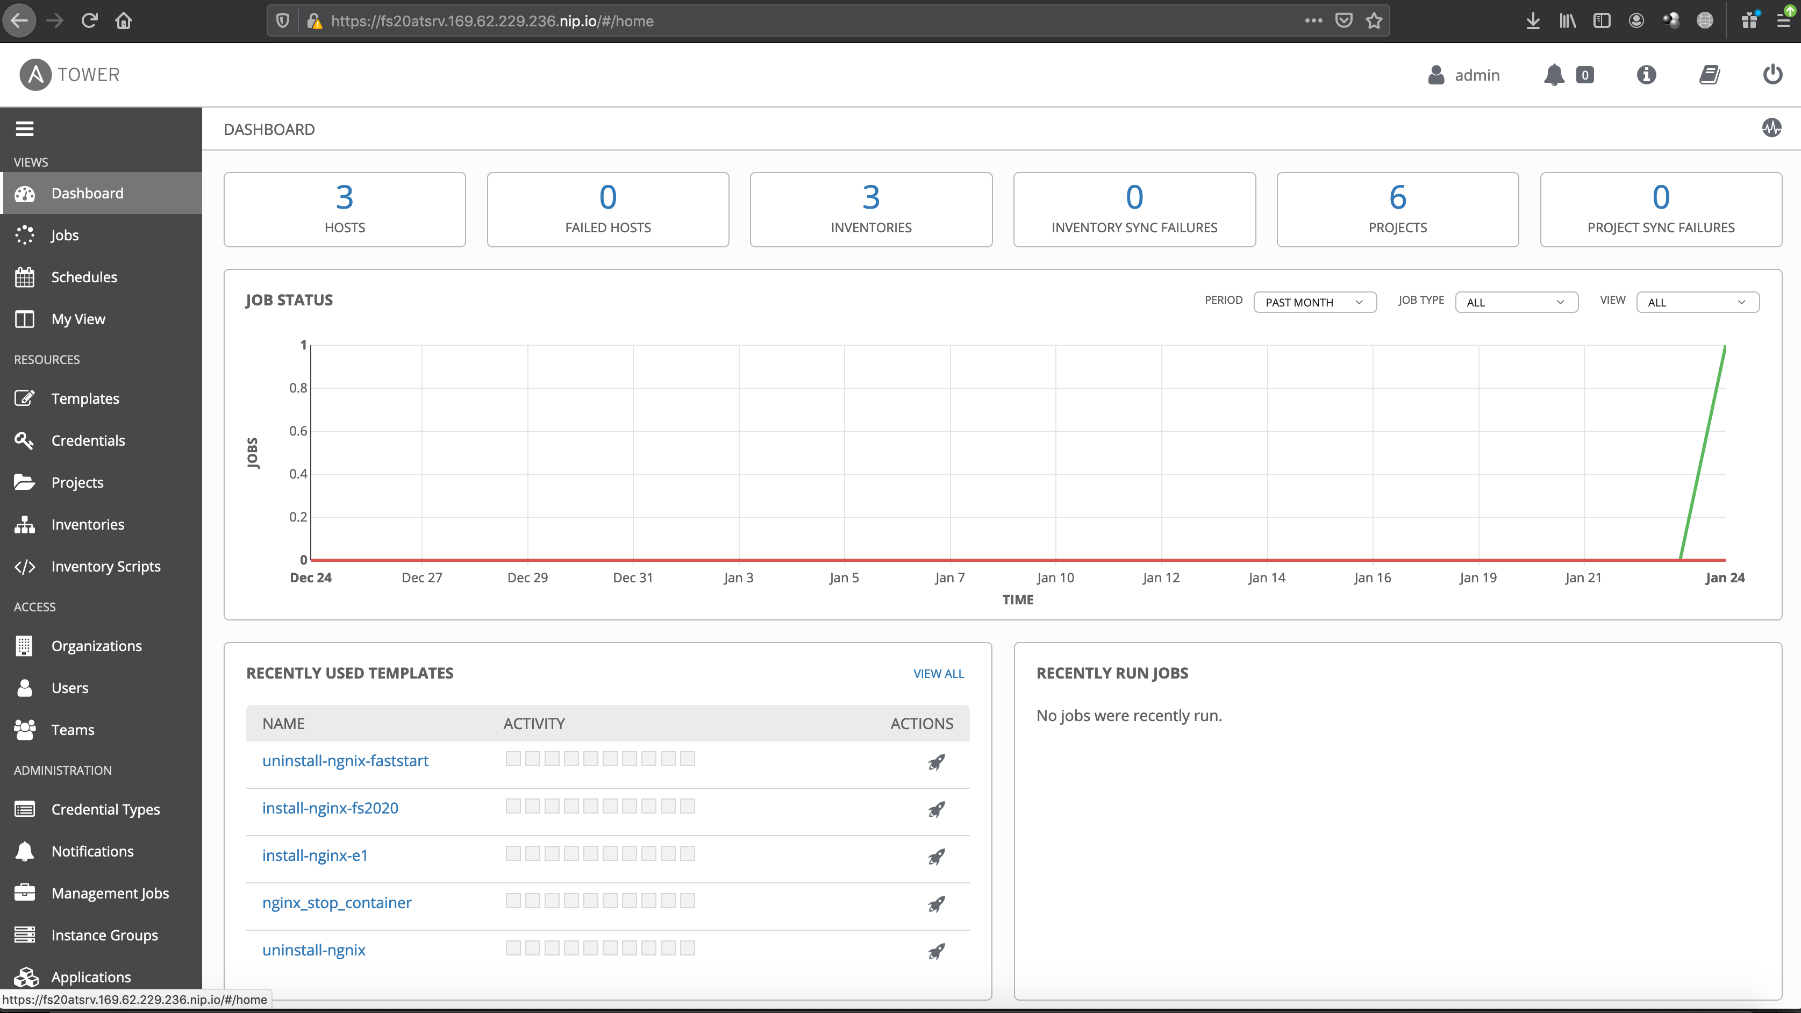
Walkthrough of CEM & Ansible Integration Lab
Ansible Tower Configuration
Create an Inventory
Create a Host
Create a Credential
Setting up a Project
Review the Ansible playbook
Create a Job Template

Slide 5
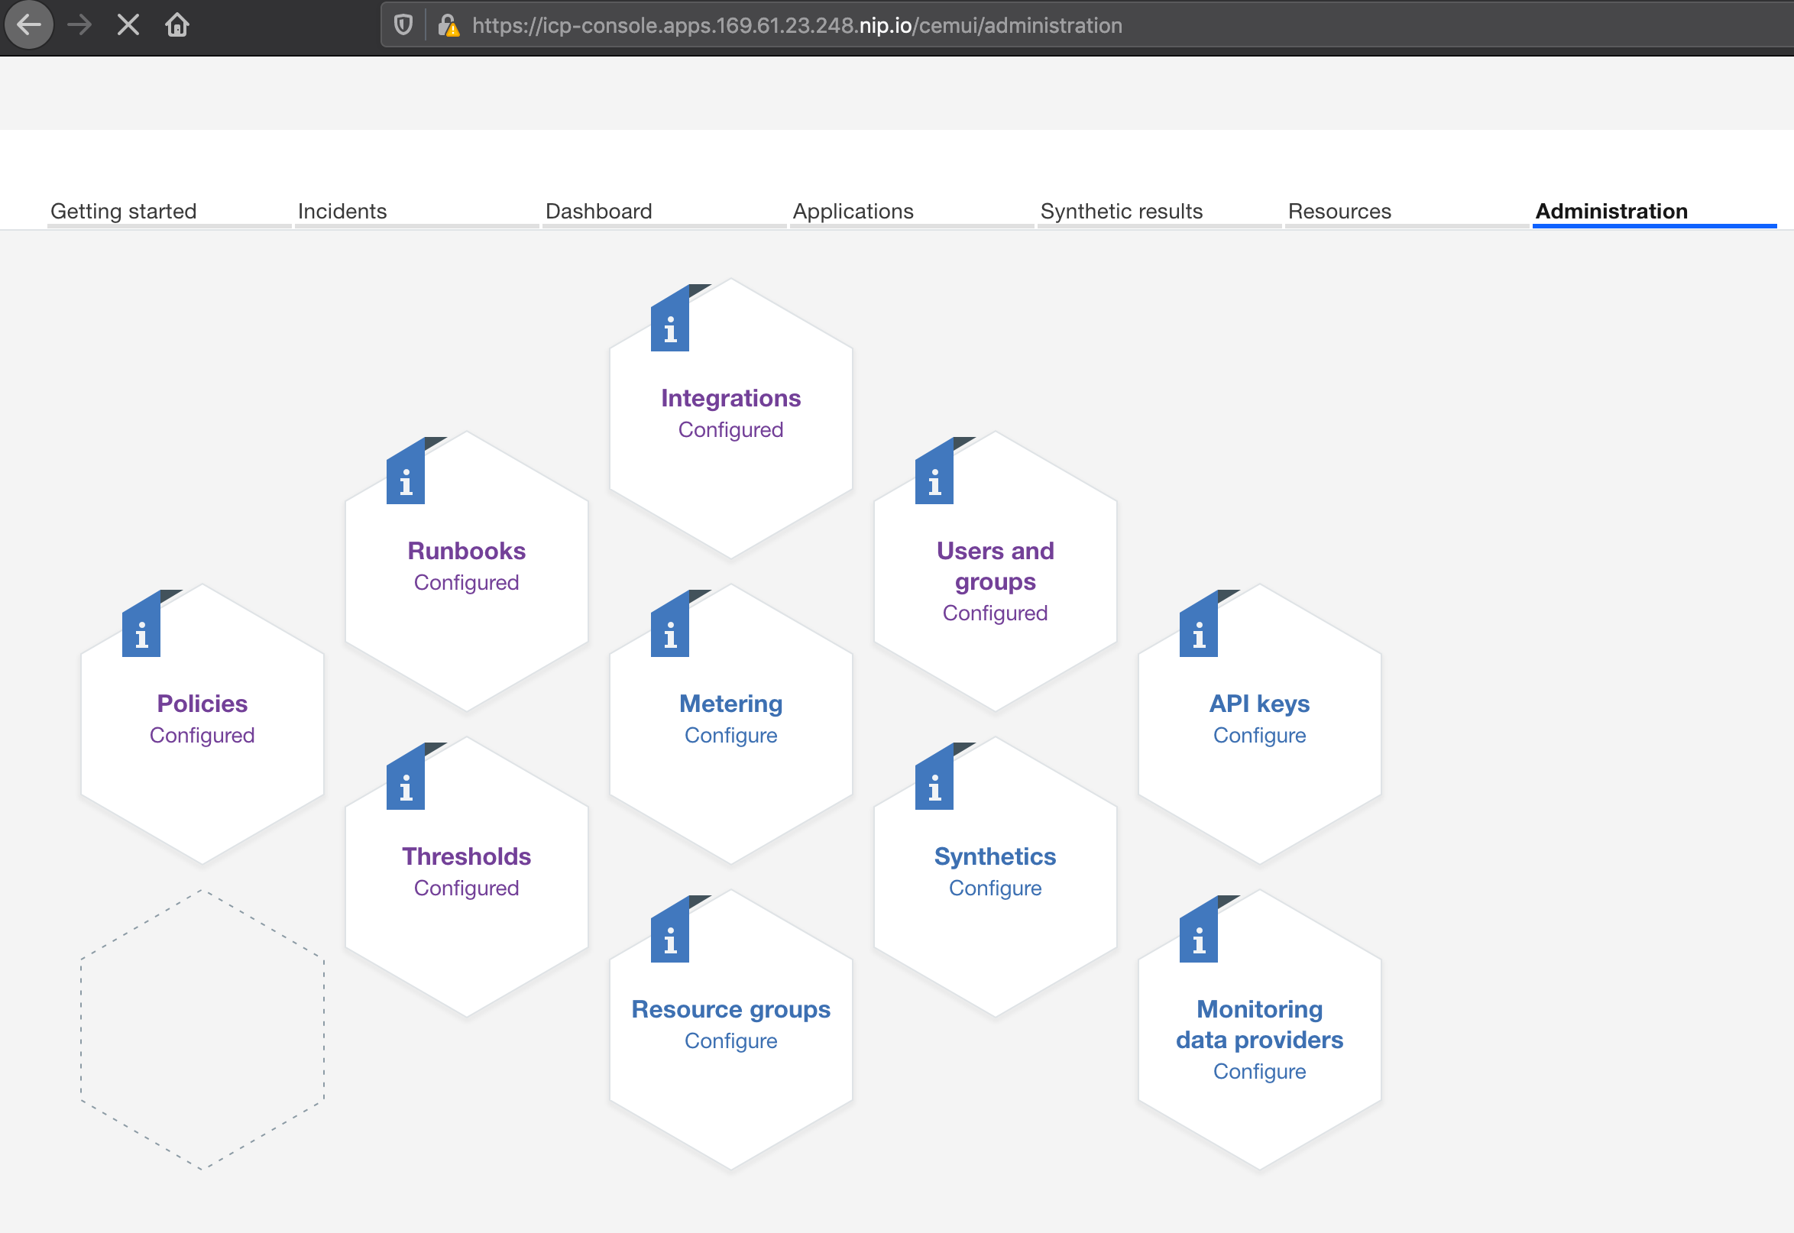
Walkthrough of CEM & Ansible Integration Lab - Tasks
CEM Configuration
Login to MCM/ICAM/CEM console
Create Automations from CEM Administration
Create RunBooks and Publish
Trigger CEM RunBook to create Nginix container
View the results
Launch Nginix URL
Trigger CEM RunBook to stop Nginix
For Lab Instructions, please check out following github repository
https://github.com/rhine59/CEMAnsibleTowerIntegration

Slide 6

Walkthrough of CEM & Ansible Integration Lab - Environment
Lab Environment Access
MCM/ICAM console URL
https://icp-console.apps.169.61.23.248.nip.io
user1 to user40 password: alpine-has-acorn-valley
CEM Runbooks URL
https://icp-console.apps.169.61.23.248.nip.io/cemui/runbooks/library
Ansible Tower URL
https://fs20atsrv.169.62.229.236.nip.io/
user1 to user40 password: alpine-has-acorn-valley
WebEx - https://ibm.webex.com/meet/richard.hine
For Lab Instructions, please check out following github repository
https://github.com/rhine59/CEMAnsibleTowerIntegration

Slide 8
Please give us your feedback – Access the survey link at the bottom of the
session details in the mobile app.

